Slide 1

BIMserver.org
BuildingSMART Denmark – April 5, 2013 Léon van Berlo M.Sc.

Slide 2
….and BIMserver.org is not a software ‘product’.
We are not software vendors….

Slide 3
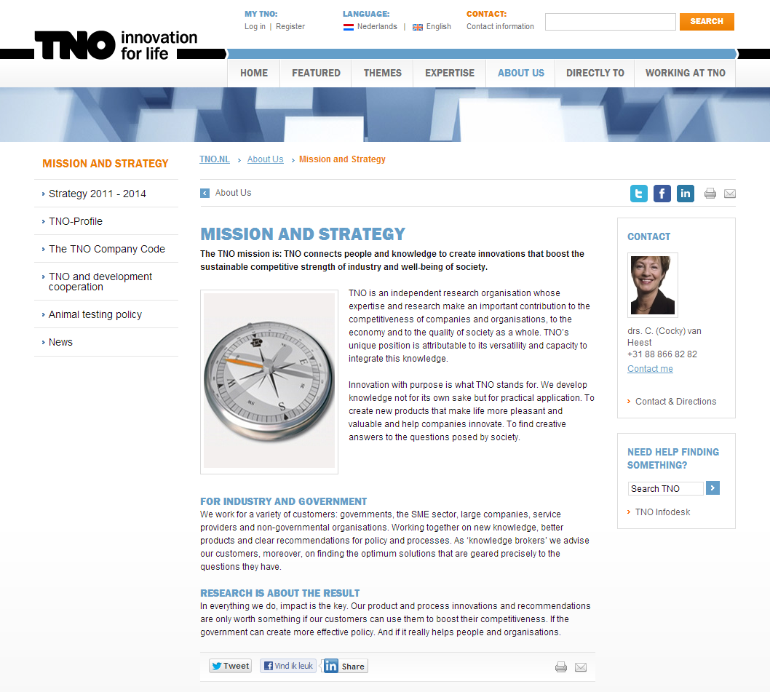

Slide 4
Our philosophy
Our mission is to help all actors in the Architectural, Engineering and Construction (AEC) industry to collaborate more efficiently and effectively (and thereby creating better buildings for lower costs).
Our goal is to create the most favorite software platform for collaboration in the AEC-industry.
Our values are the core principles that define everything we do:
Innovative
Reliable
Responsible
Commercial use
http://bimserver.org/about/philosophy/

Slide 5
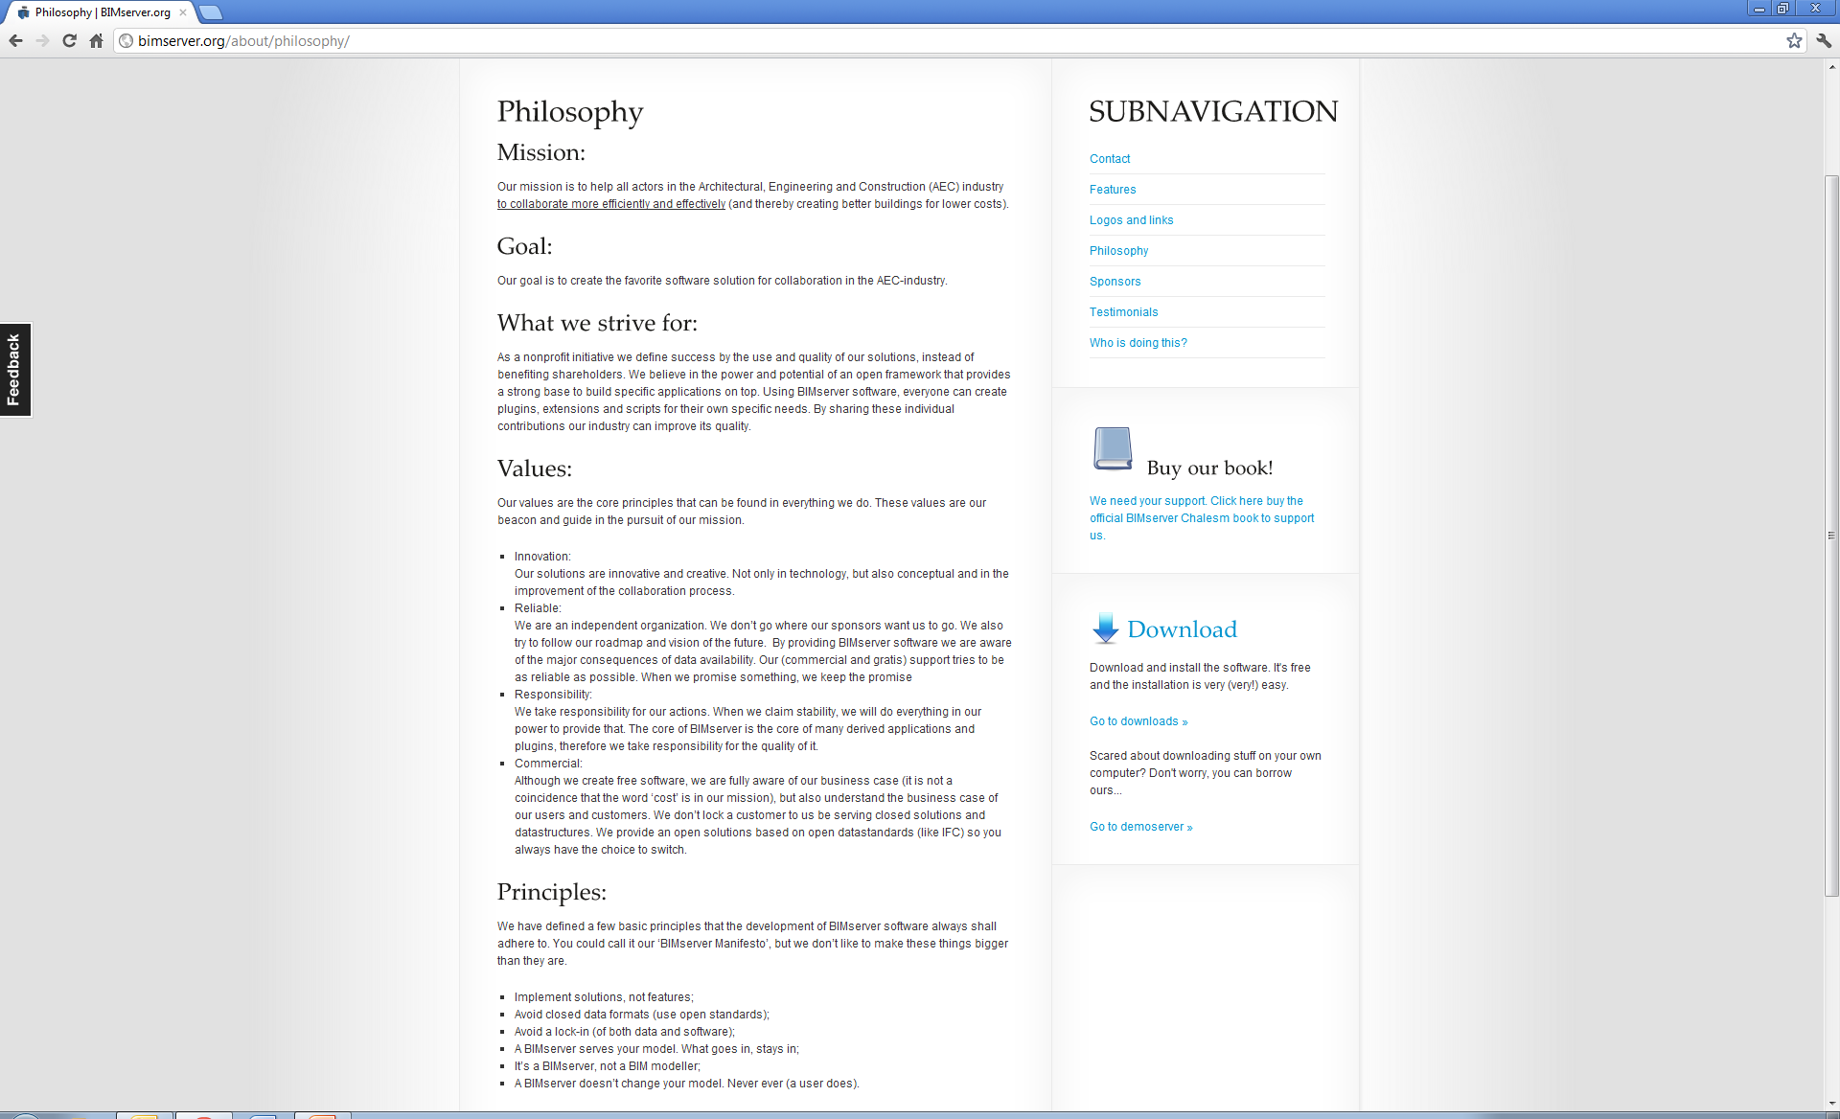

Slide 6
Strategy:
Mission: help AEC to collaborate more efficiently and effectively
+
Position: Not software vendors
Creating a platform for others to build on top / extend;
No direct end-users;
Creating a snowball effect;
=
Goal: create most favorite platform by lowering the threshold for developers of niche applications
=
Mission: help AEC to collaborate more efficiently and effectively

Slide 7
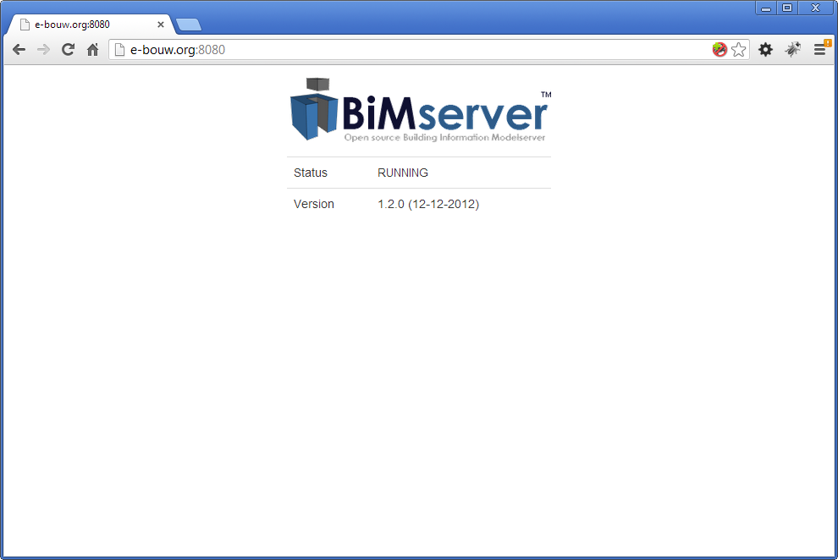
How a ‘platform’ looks….

Slide 8
What BIMserver is….
Open and stable core to use and build on top
Core server features like revisions, authorization, compare, query, merging, etc..
Open interfaces, lots of network protocols (soap, PB, json)
Open standards
Plugin framework for render engines (like IfcOpenShell); ObjectIDMs & Query engines (like BimQL)
Flexible admin configuration & fine-tuning
Open source
etc…

Slide 9
The plugin framework (example for ‘output’)
GUI plugins
Remote Services
Internal apps
Serializers
EMF
core
Object
IDMs
Database(s)
ServiceInterfaces
(4 protocols)
Including BIMSie standard
Merge
algorithms
Render engines
Query engines
Compare algorithms
MVDs
(xml)

Slide 10
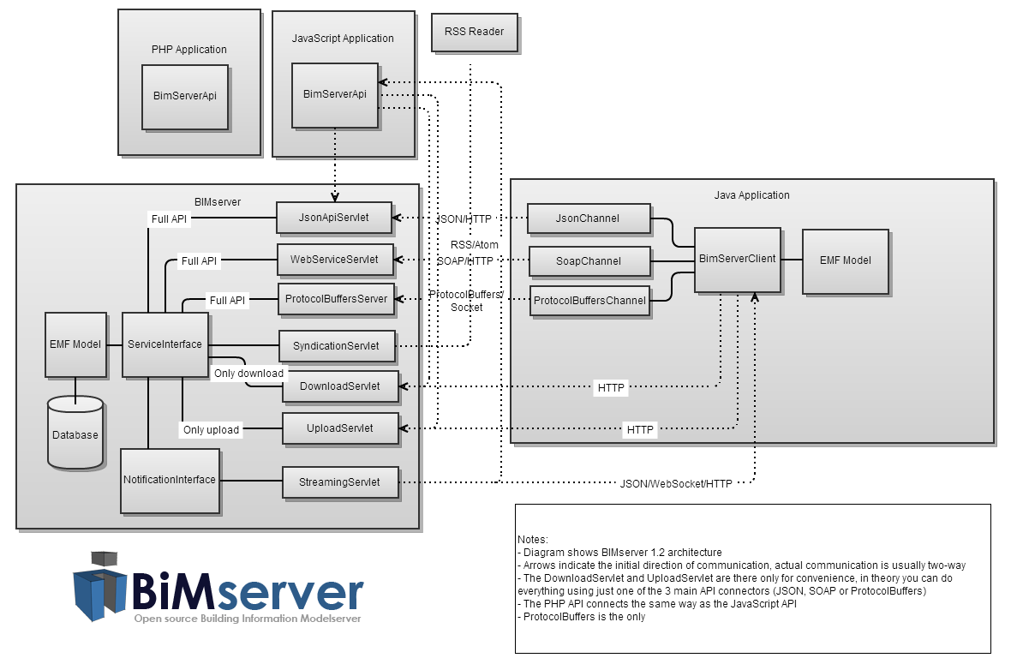
BIMSie

Slide 11
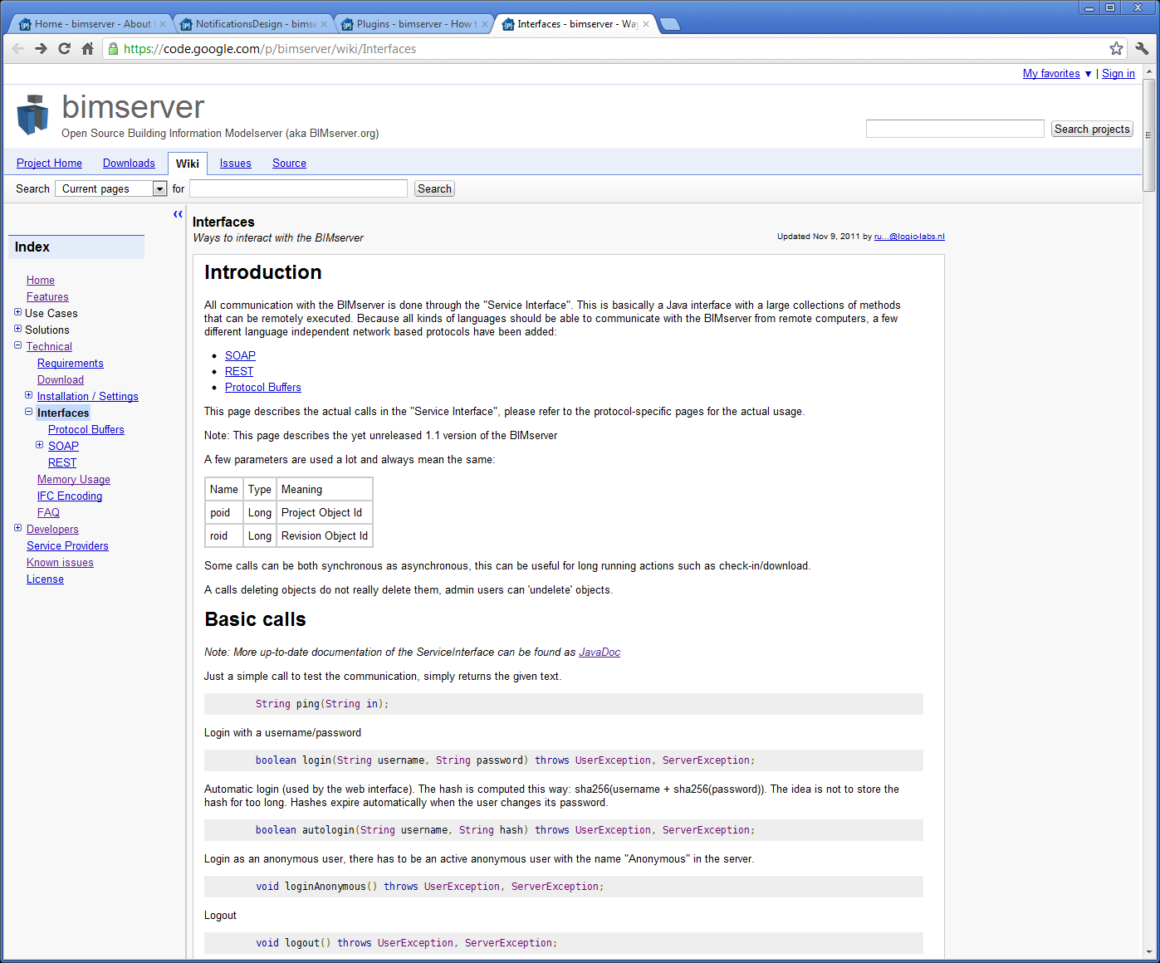

Slide 12
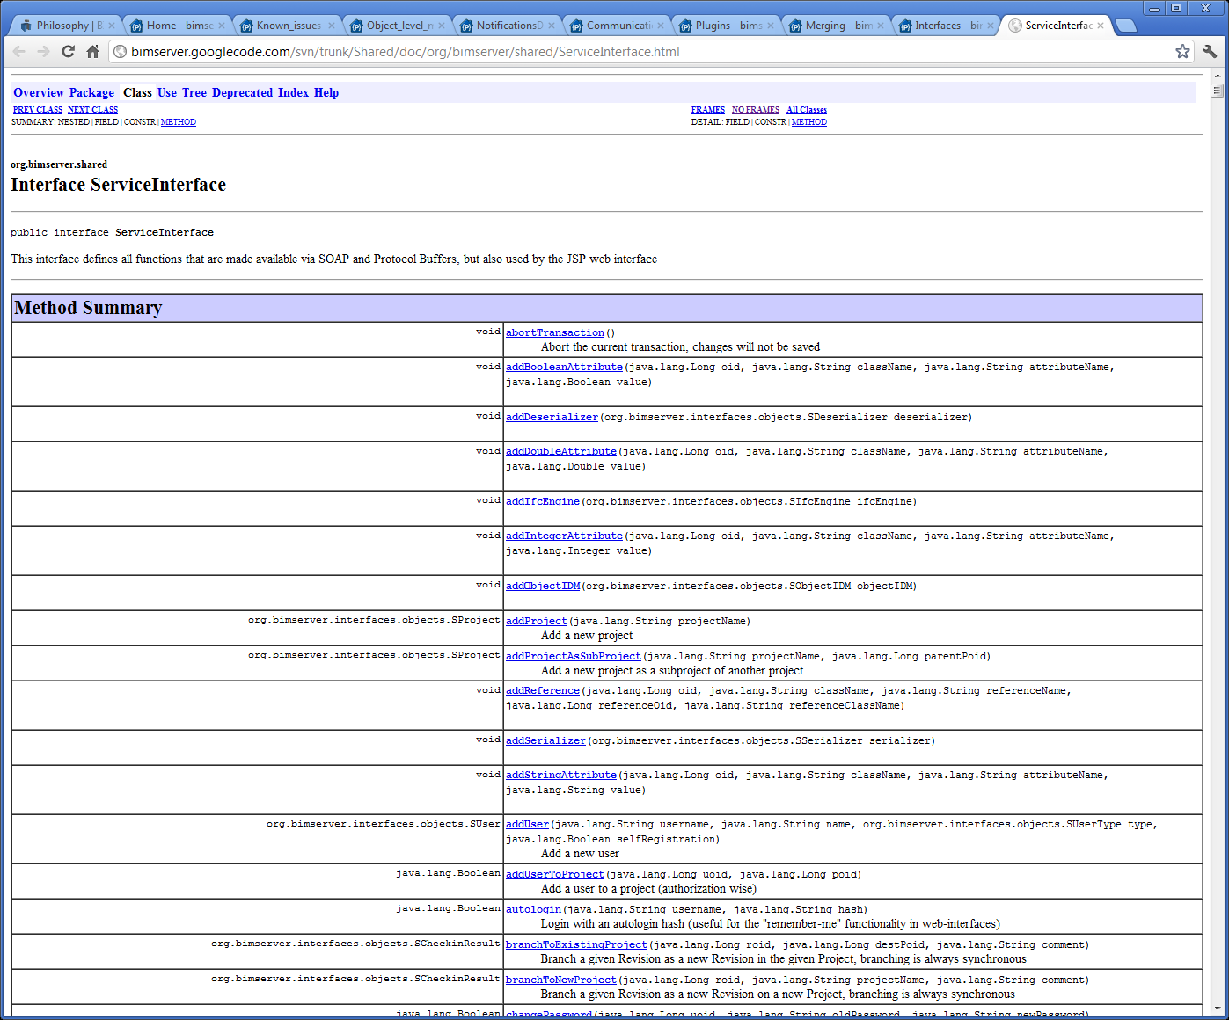

Slide 13
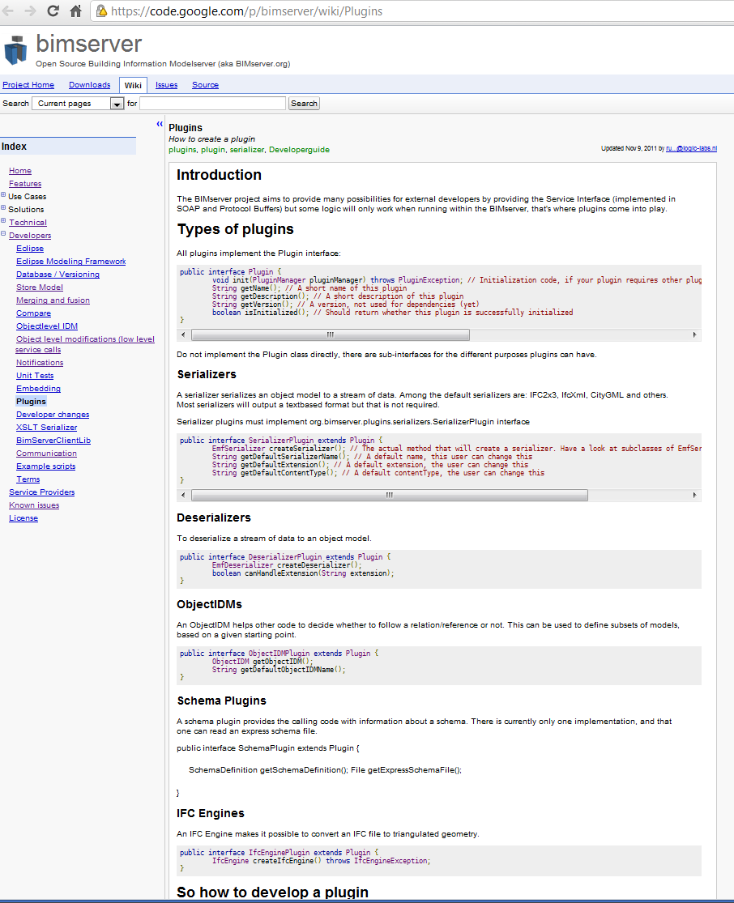

Slide 14
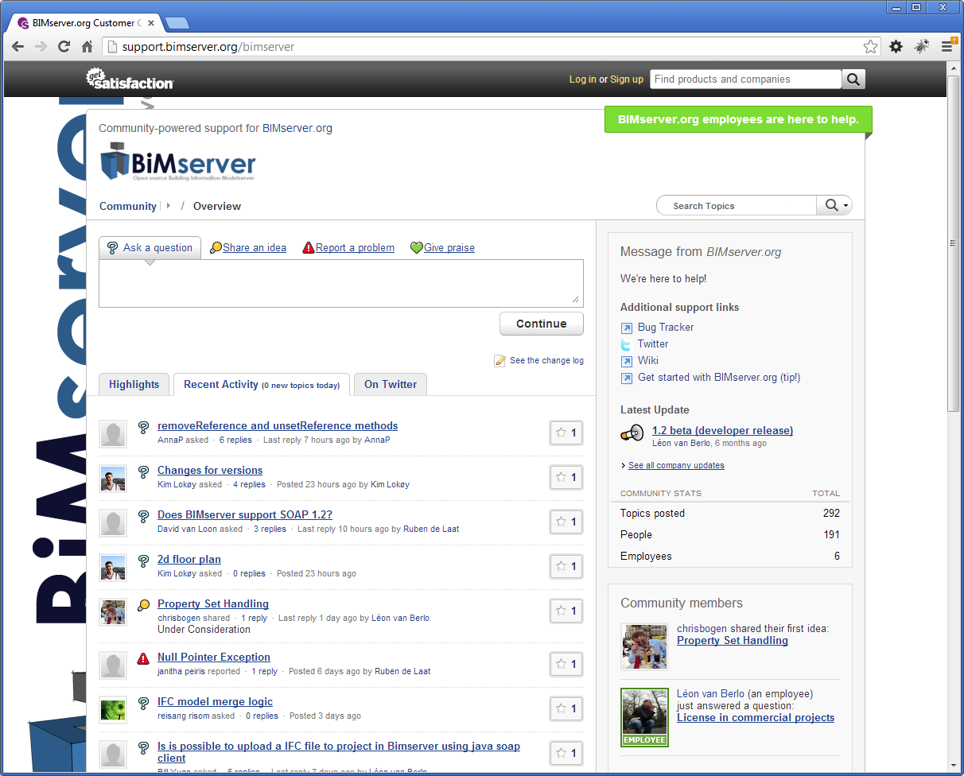

Slide 15
Some examples of tools that use BIMserver

Slide 16
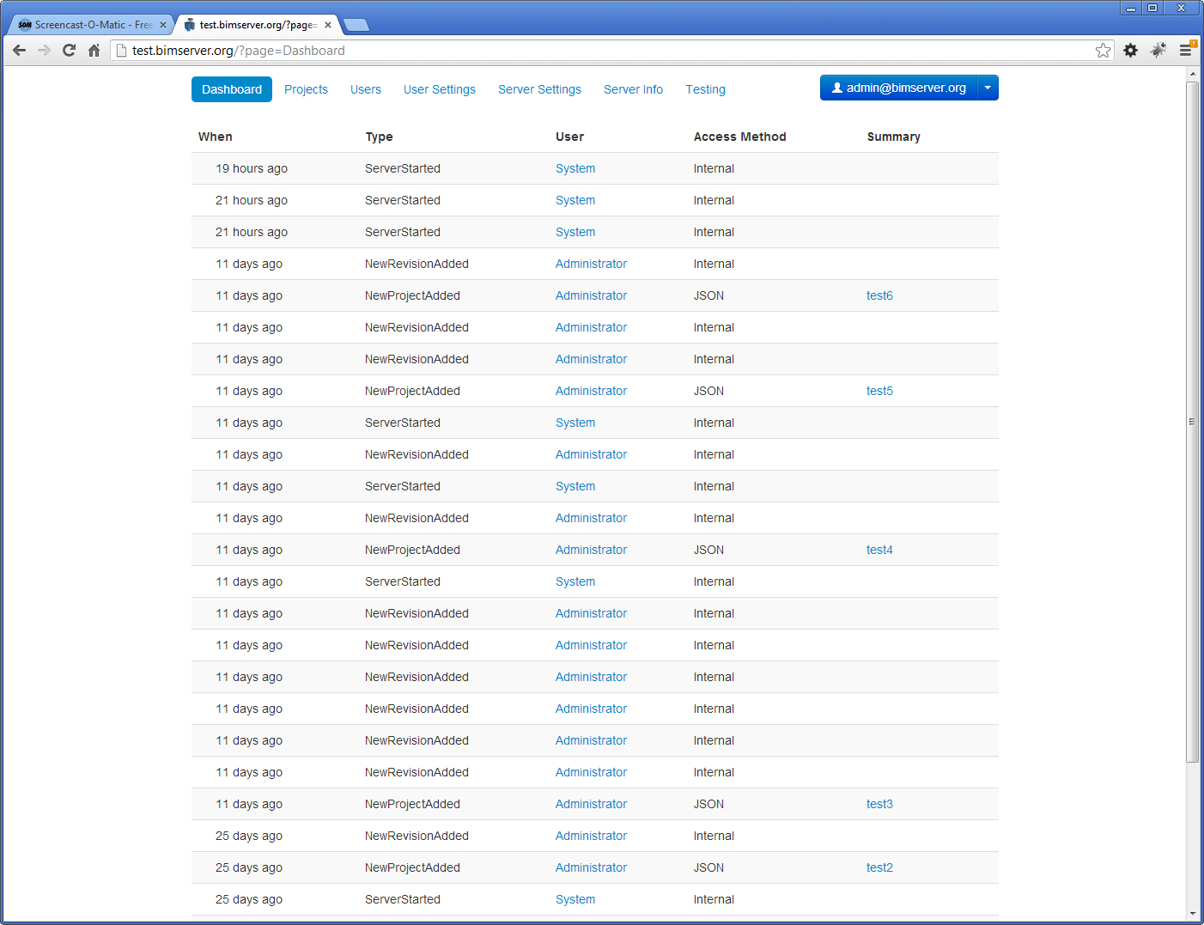
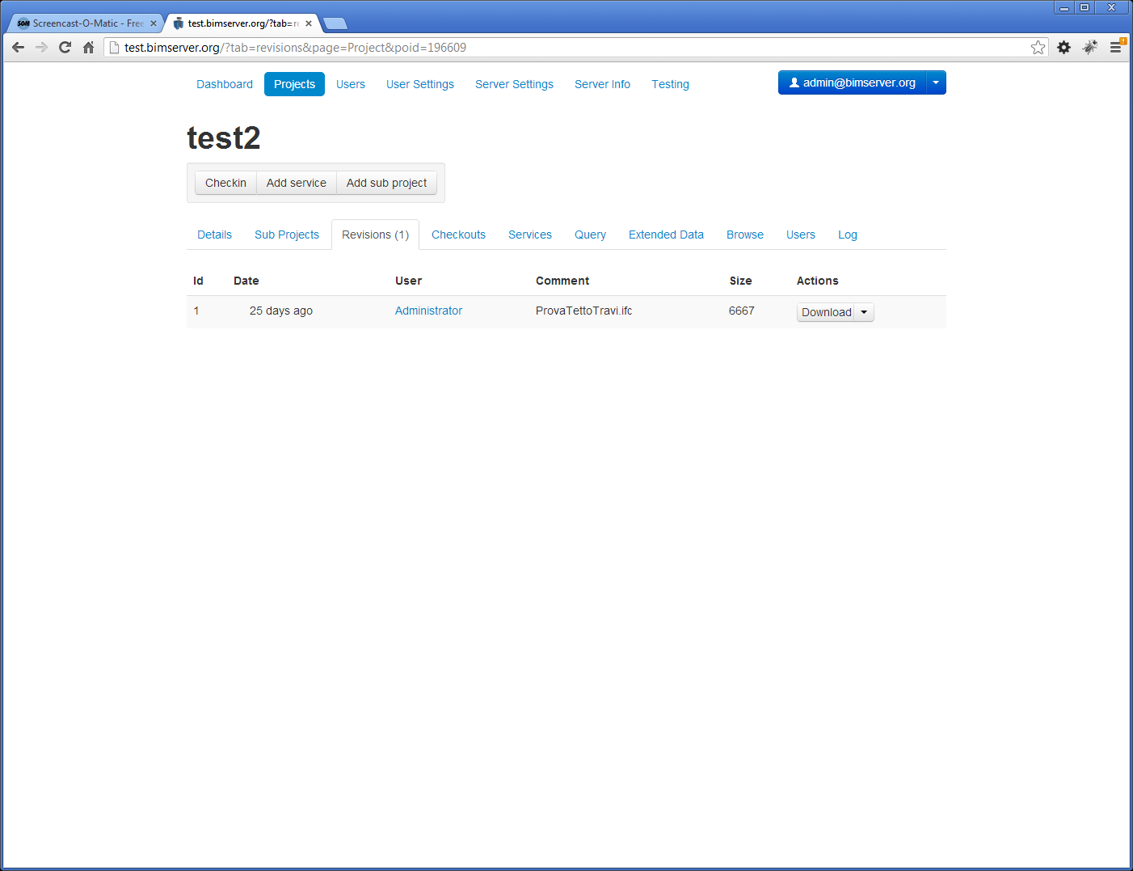
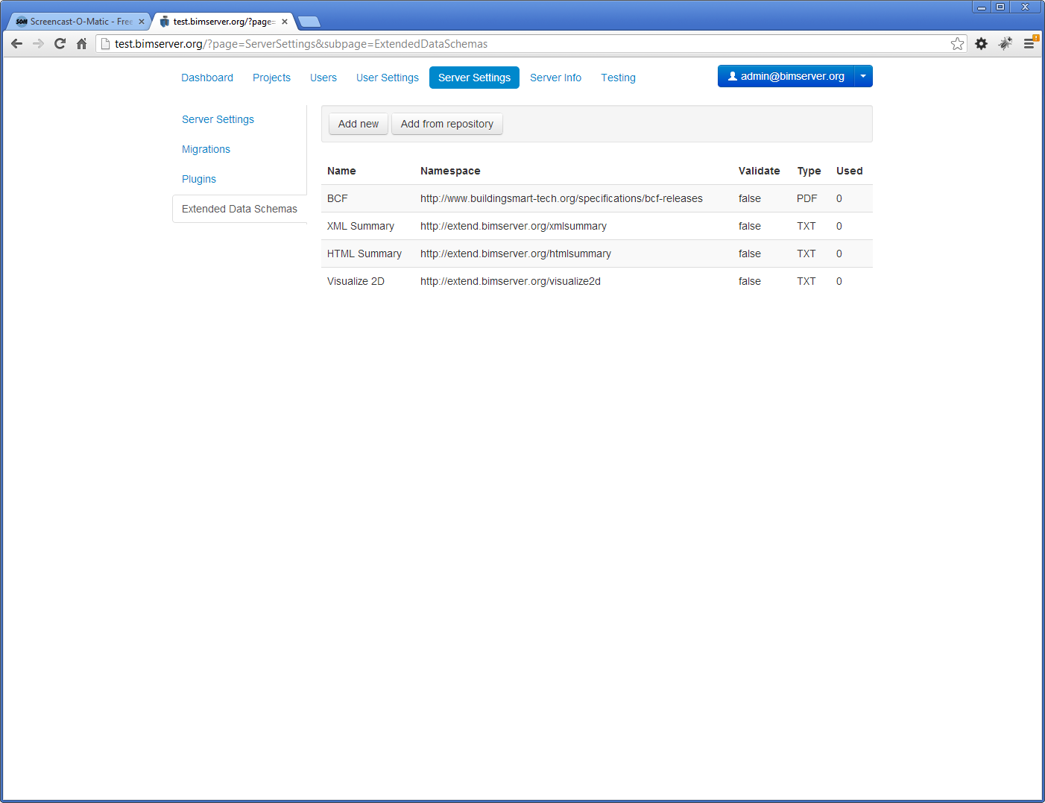
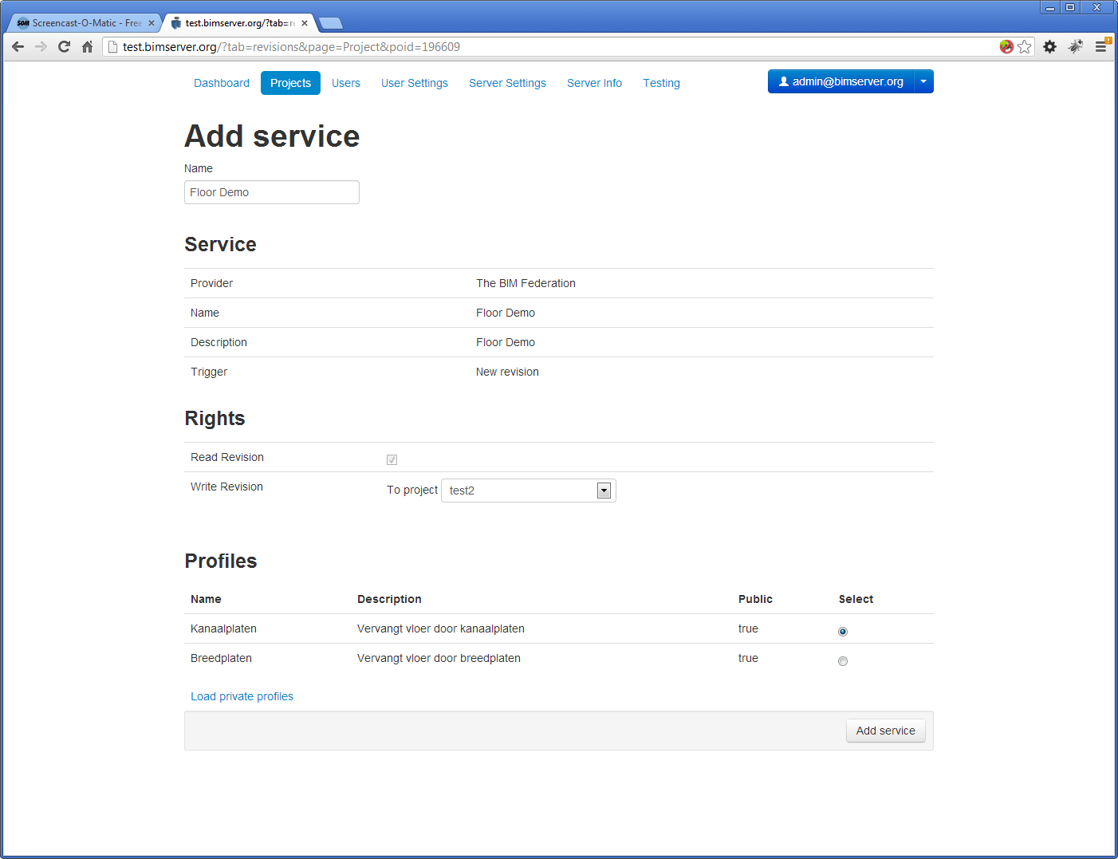

Slide 17
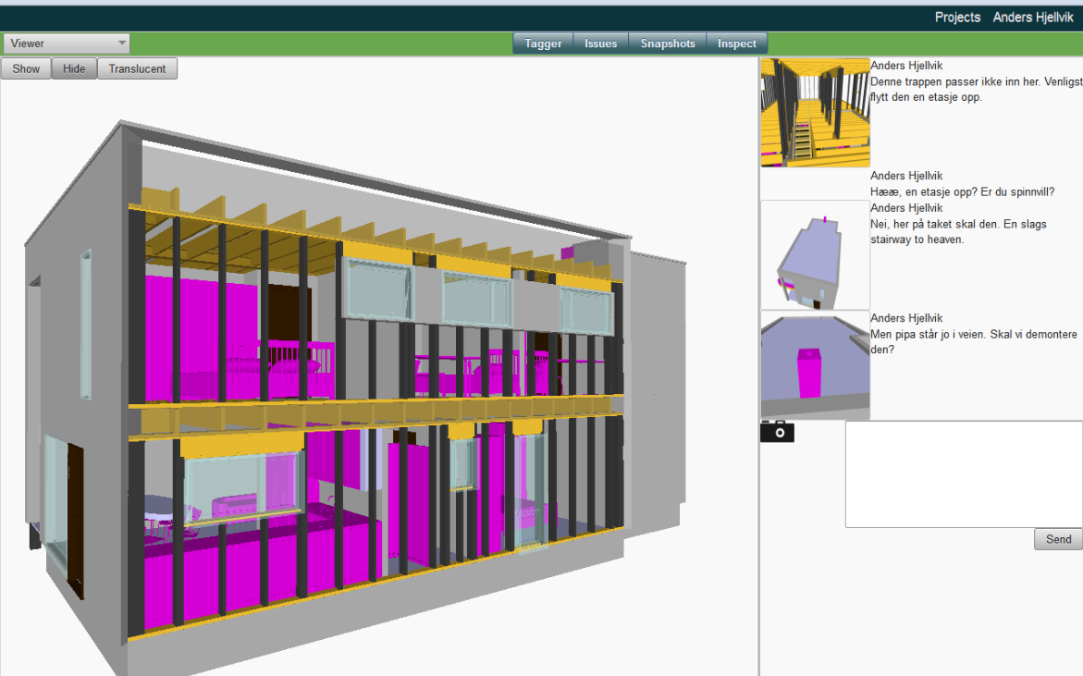
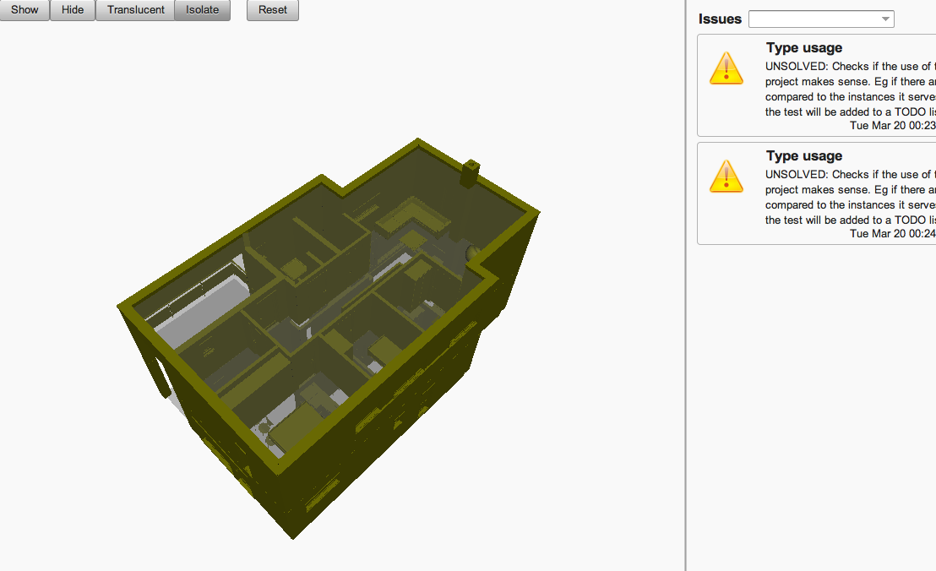

Slide 18
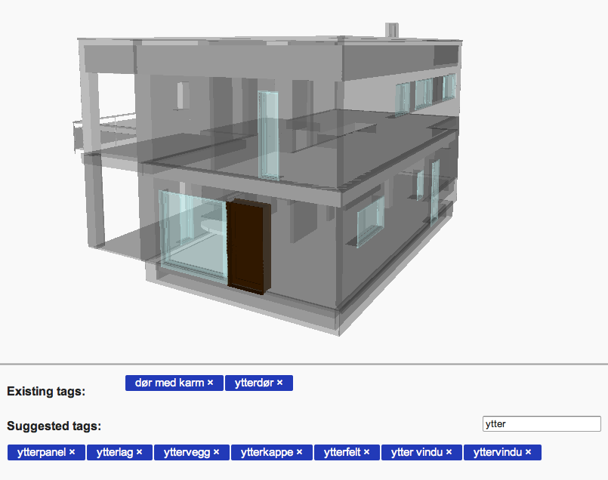
catenda

Slide 19
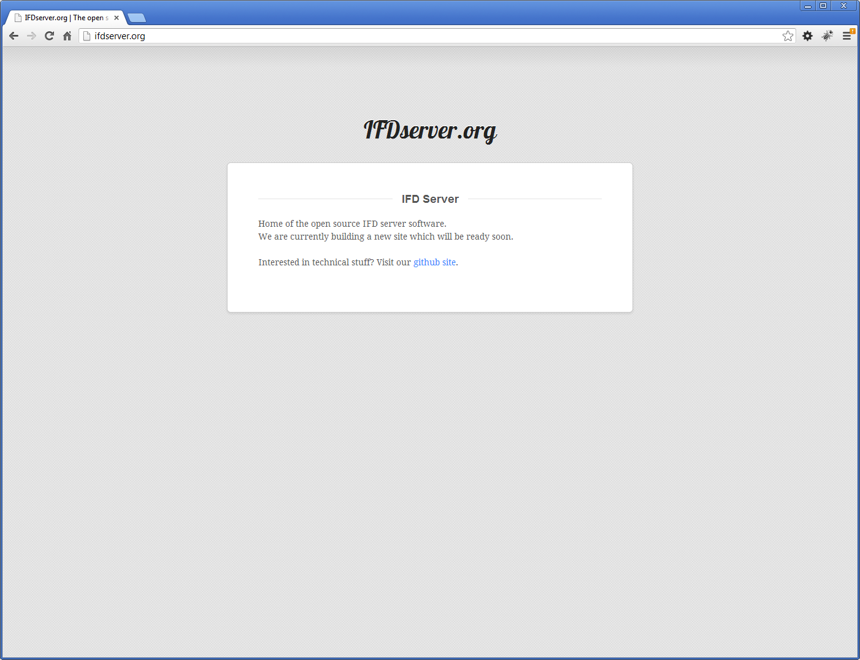

Slide 20
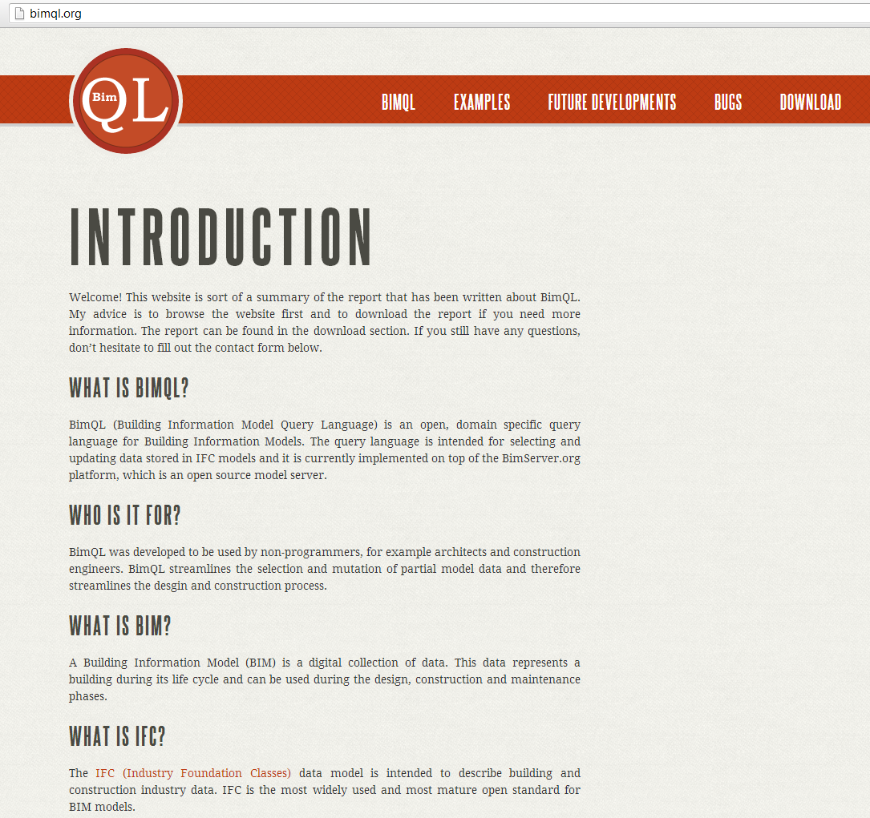

Slide 21
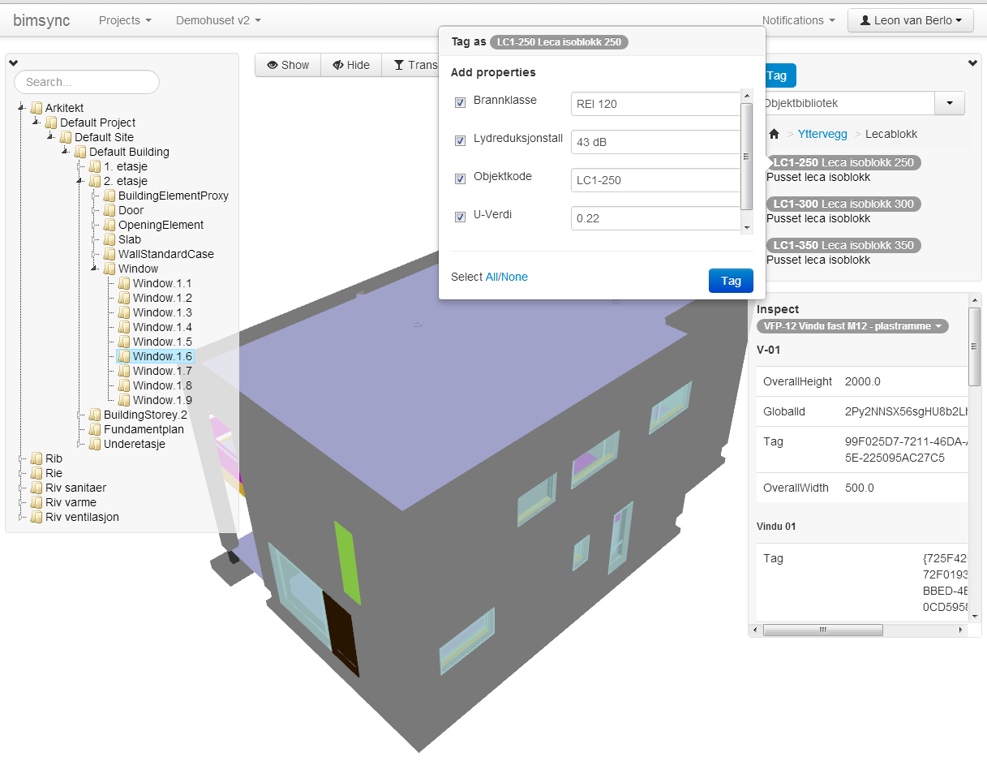

Slide 22
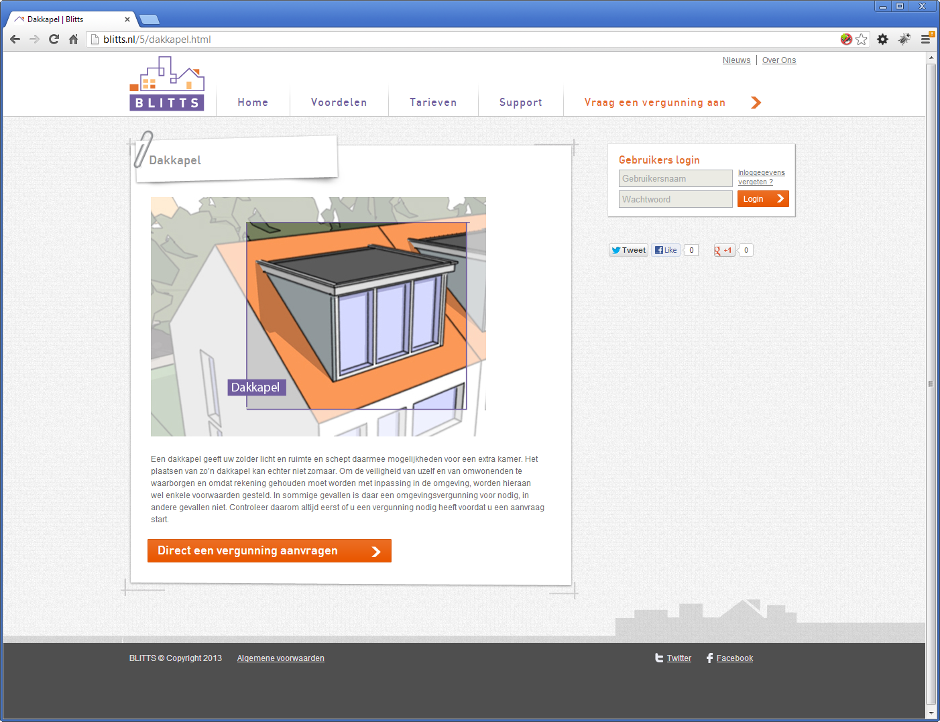

Slide 23
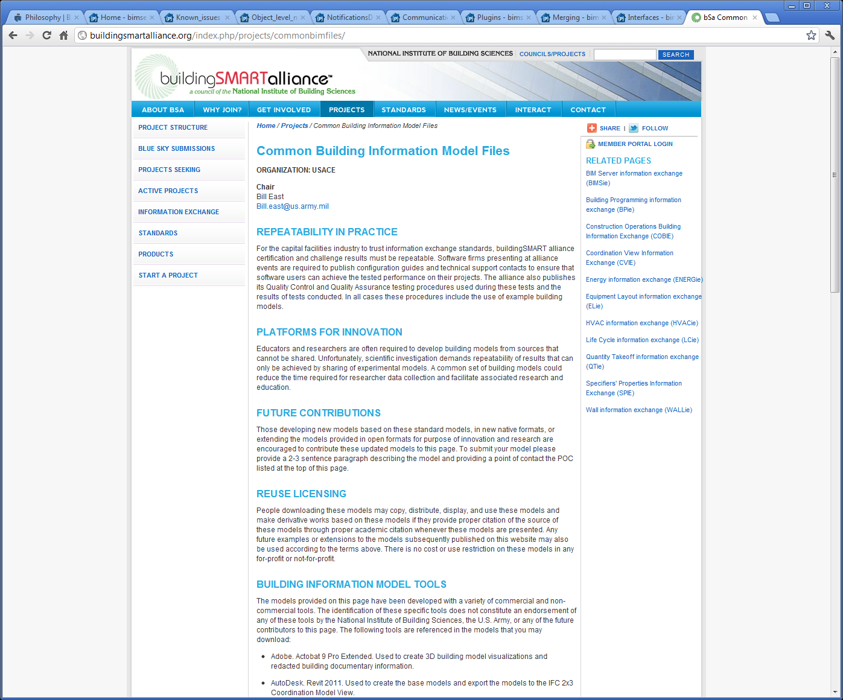

Slide 24
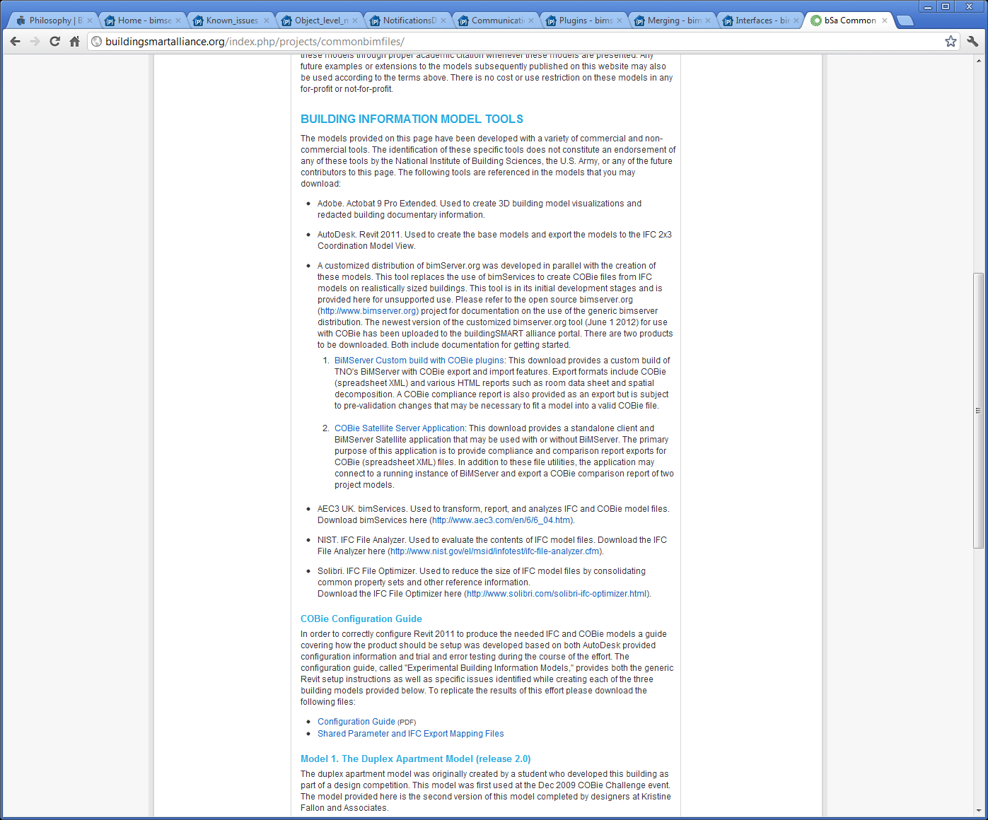

Slide 25
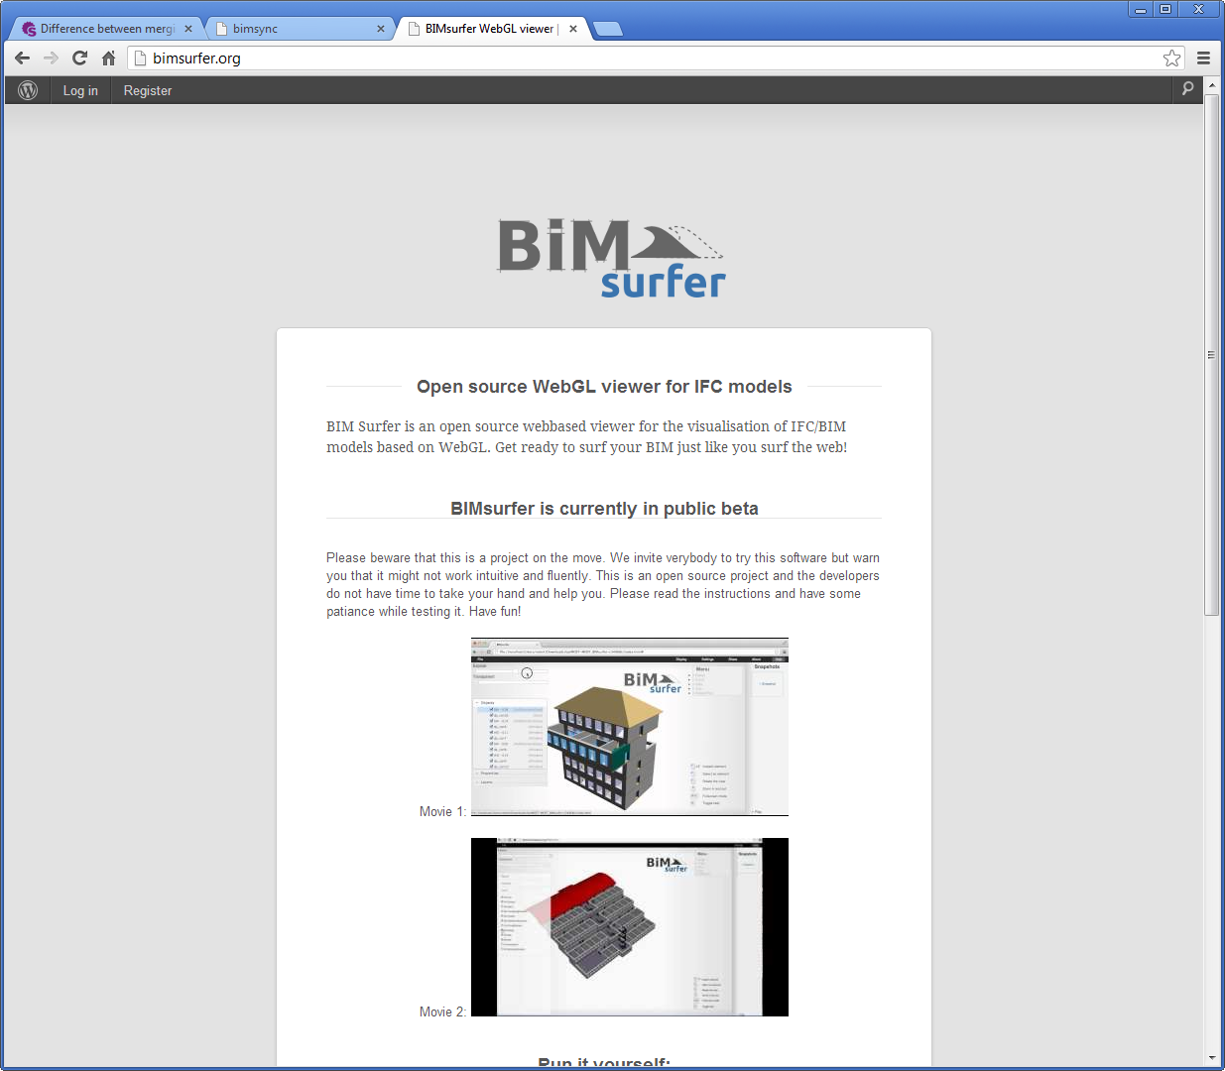

Slide 26
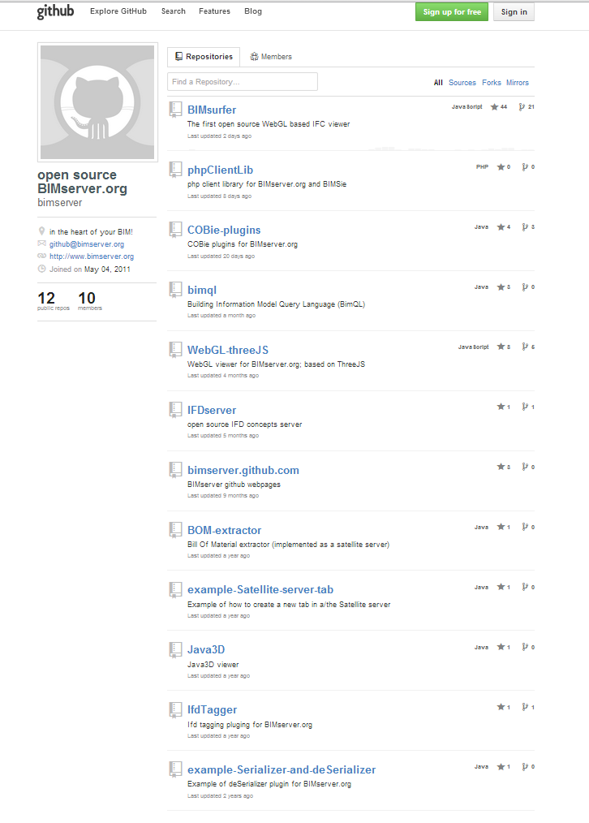

Slide 27
And many more…
Floorplan generator
Clash detection web service
GeoBIM transformation (CityGML)
Automatic design requirements check
Online Facility Management service
BIM issue management app
BillOfMaterial extractor
LOD level checker
And probably lots we don’t know of….

Slide 28
So you might already be using BIMserver.org?!

Slide 29
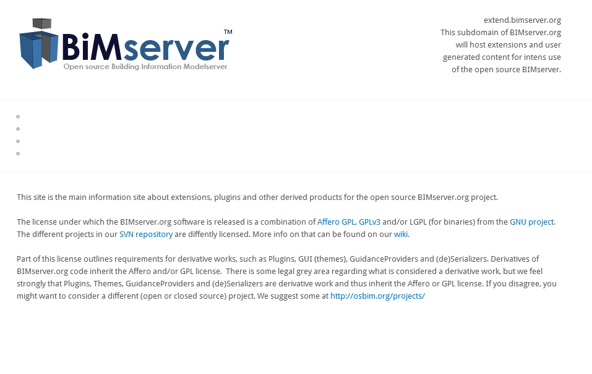
http://extend.bimserver.org

Slide 30
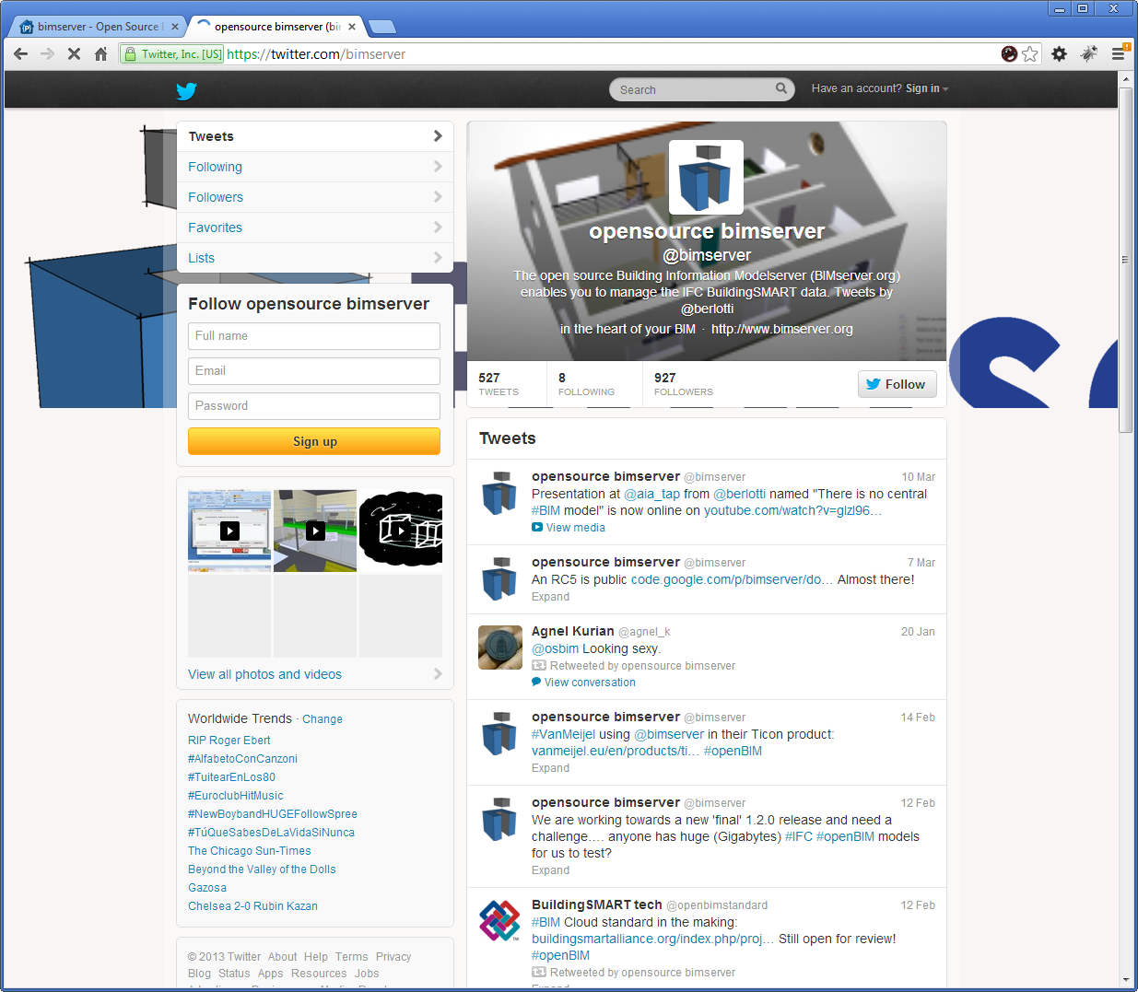
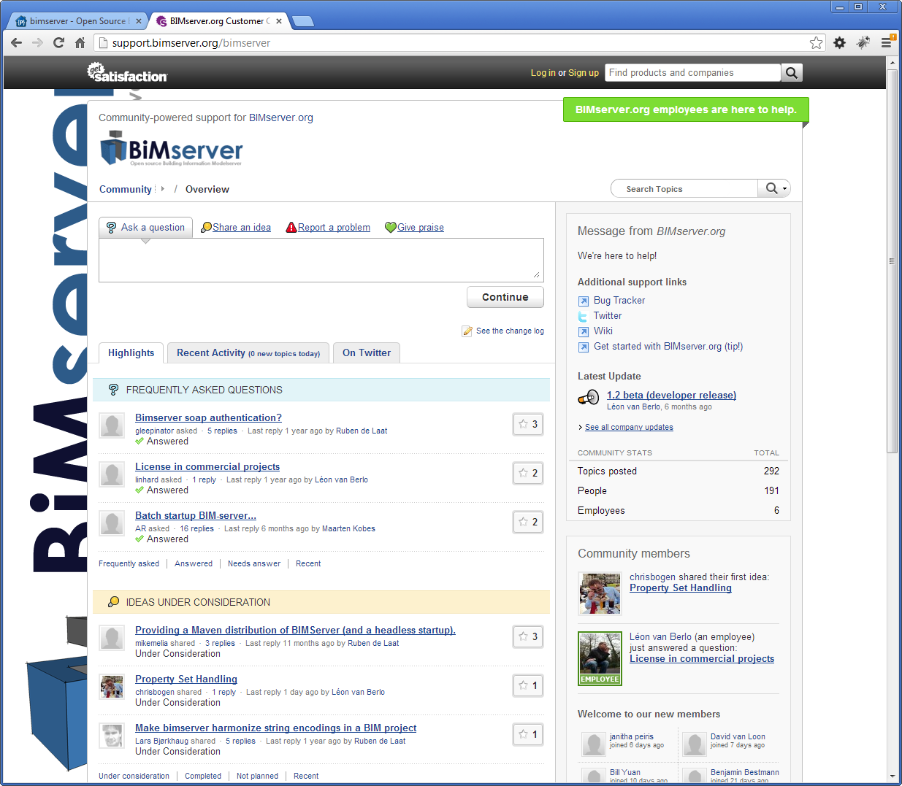
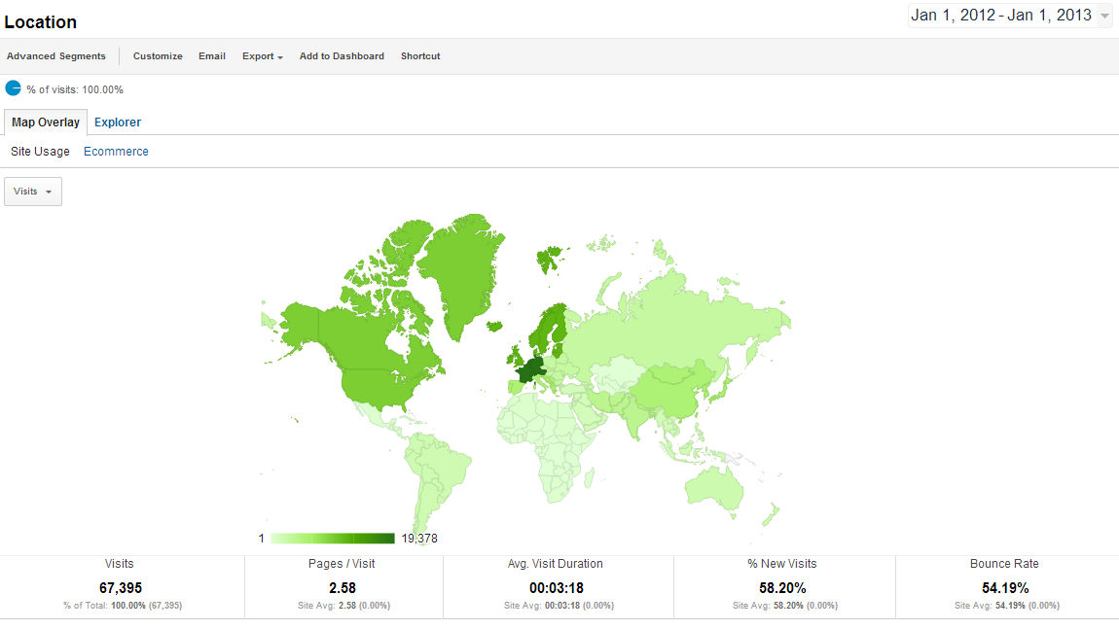
Join the growing number of people
+/- 150 developers on forum
> 4000 bimserver users in 2012*
> 5000 downloads since 1.0
Around 6000 unique site visitors/month
Great user testimonials
* That we know of because they send us statistics

Slide 31
Stuff we are working on right now
BIMSie cloud service interfaces (BuildingSMART Alliance US)
mvdXML
IFC 4

Slide 32

Join our mission!

